Slide 1

Project 1: API Development and Testing
University of British Columbia Okanagan
COSC 499 - Summer 2022
Wasi-ul-hassan Raza
Calvin Qu
Po-chia Wei
Austin Wong
2022.06.07

Slide 2

01
Project and Client Introduction
02
Key Requirements and USE Cases
CONTENTS
03
Login Authentication
04
Payment Transactions
05
Tech Stack and Testing Plans
06
Questions?

Slide 3
Project and Client Introduction
1
Service purchasing platform
Small startup
Ios beta with only front end developed

Slide 4
Key Requirements and USE Cases
2
User side USE Case Diagram
Admin side USE Case Diagram
ER Diagram

Slide 5
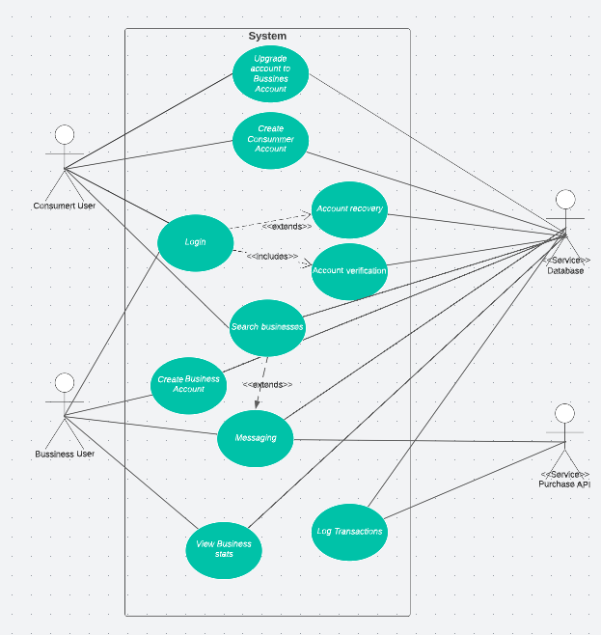
User side USE Case Diagram
Back

Slide 6
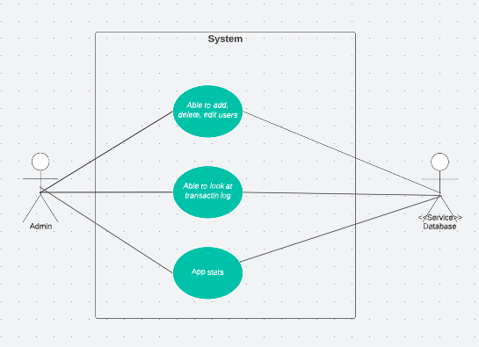
Admin side USE Case Diagram
Back

Slide 7
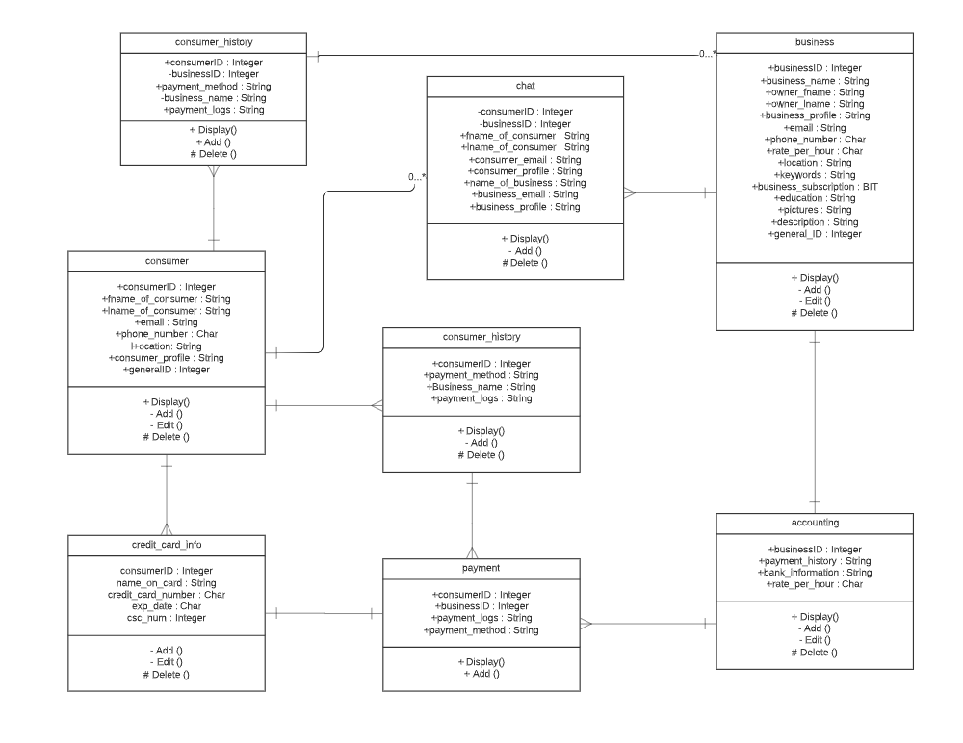
ER Diagram

Slide 8
3
Login Authentication

Slide 9
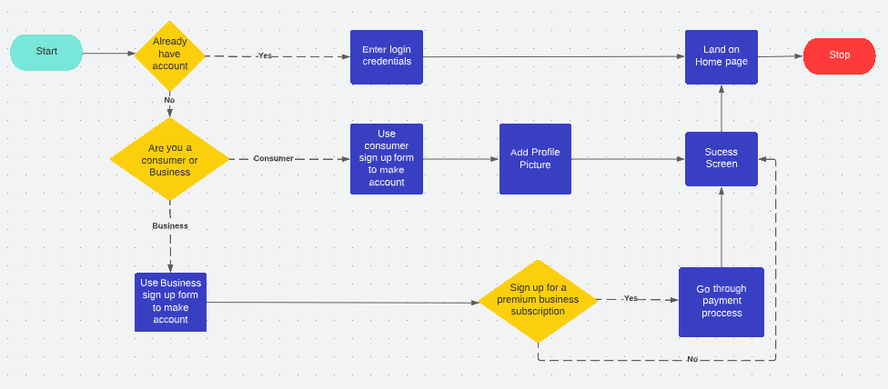
Login Authentication

Slide 10
4
Payment Transactions

Slide 11
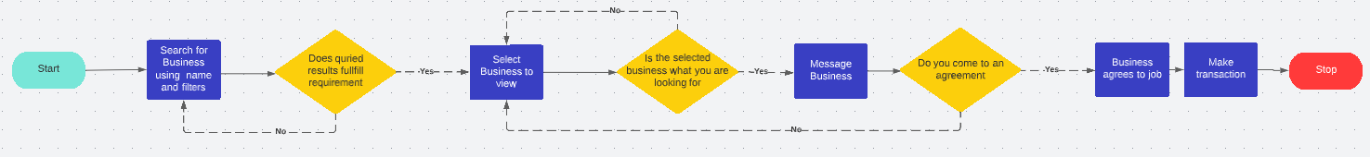
Payment Transactions

Slide 12
Tech Stack and Testing Plans
5
MySQL: Database Development
Node.js: API development
Express: Node.js library primarily used to create login authentication system
Stripe: Purchasing API
Mocha: Unit Tests
Develop >> Unit Test >> Code review >> integration test

Slide 13
Any Questions?

